Slide 1

GenHack 2025 - Week 2: Visualization & Communication
Urban Heat Island Analysis
Berlin, Germany
Team 19 UrbanCoolers
November 24, 2025

Slide 2
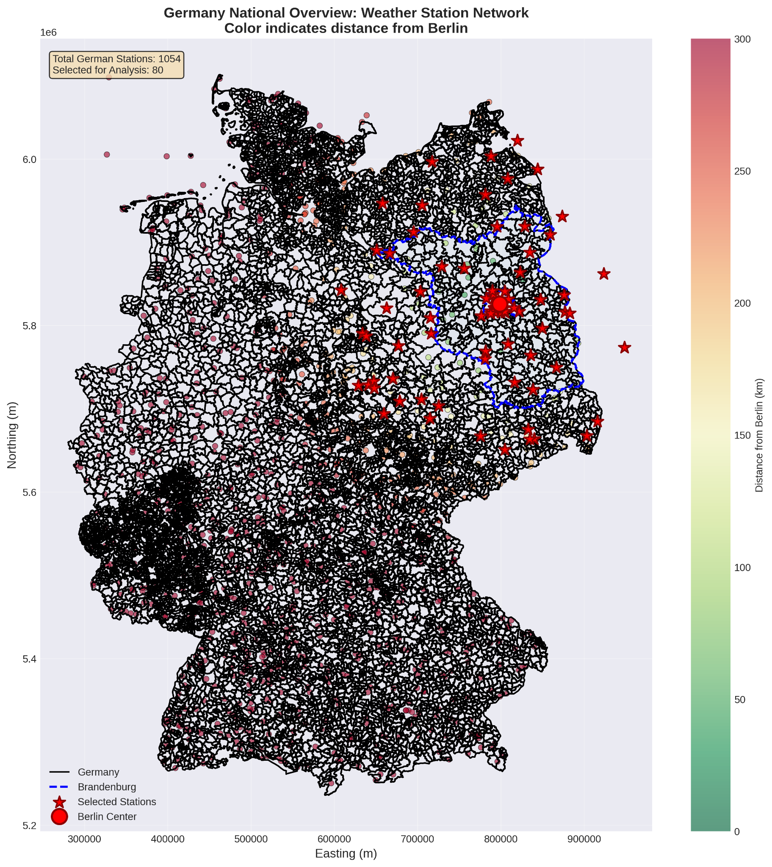
Berlin Urban Heat Island Analysis
Quantifying the City's Thermal Signature
Research Question: How does urbanization in Berlin affect local climate patterns, and how well do current climate models capture these effects?
Study Area:
Berlin: 893 km², 3.7M inhabitants
Brandenburg: 29,697 km², 2.5M inhabitants
Data Period: 2020-2023

Slide 3
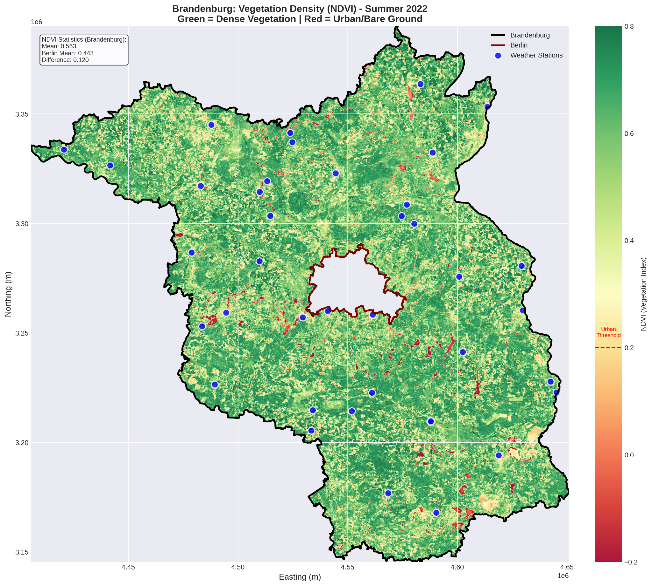
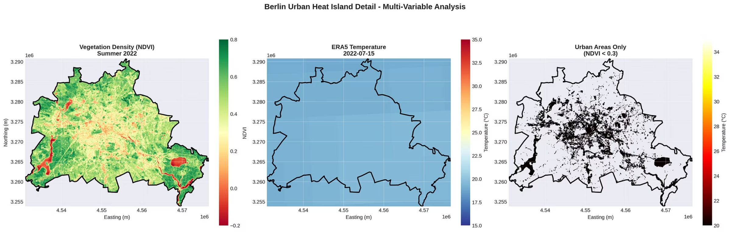
Comprehensive Data Approach:
Three Data Sources:
80 Weather Stations
ERA5 Reanalysis
Sentinel-2 NDVI
(Urban/Suburban/Rural gradient)
(9km resolution, 2020-2023)
(80m resolution, 16 quarters)
Station Classification:
Urban (8): <10km from center
Suburban (14): 10-30km from center
Rural (58): 30-200km from center

Slide 4
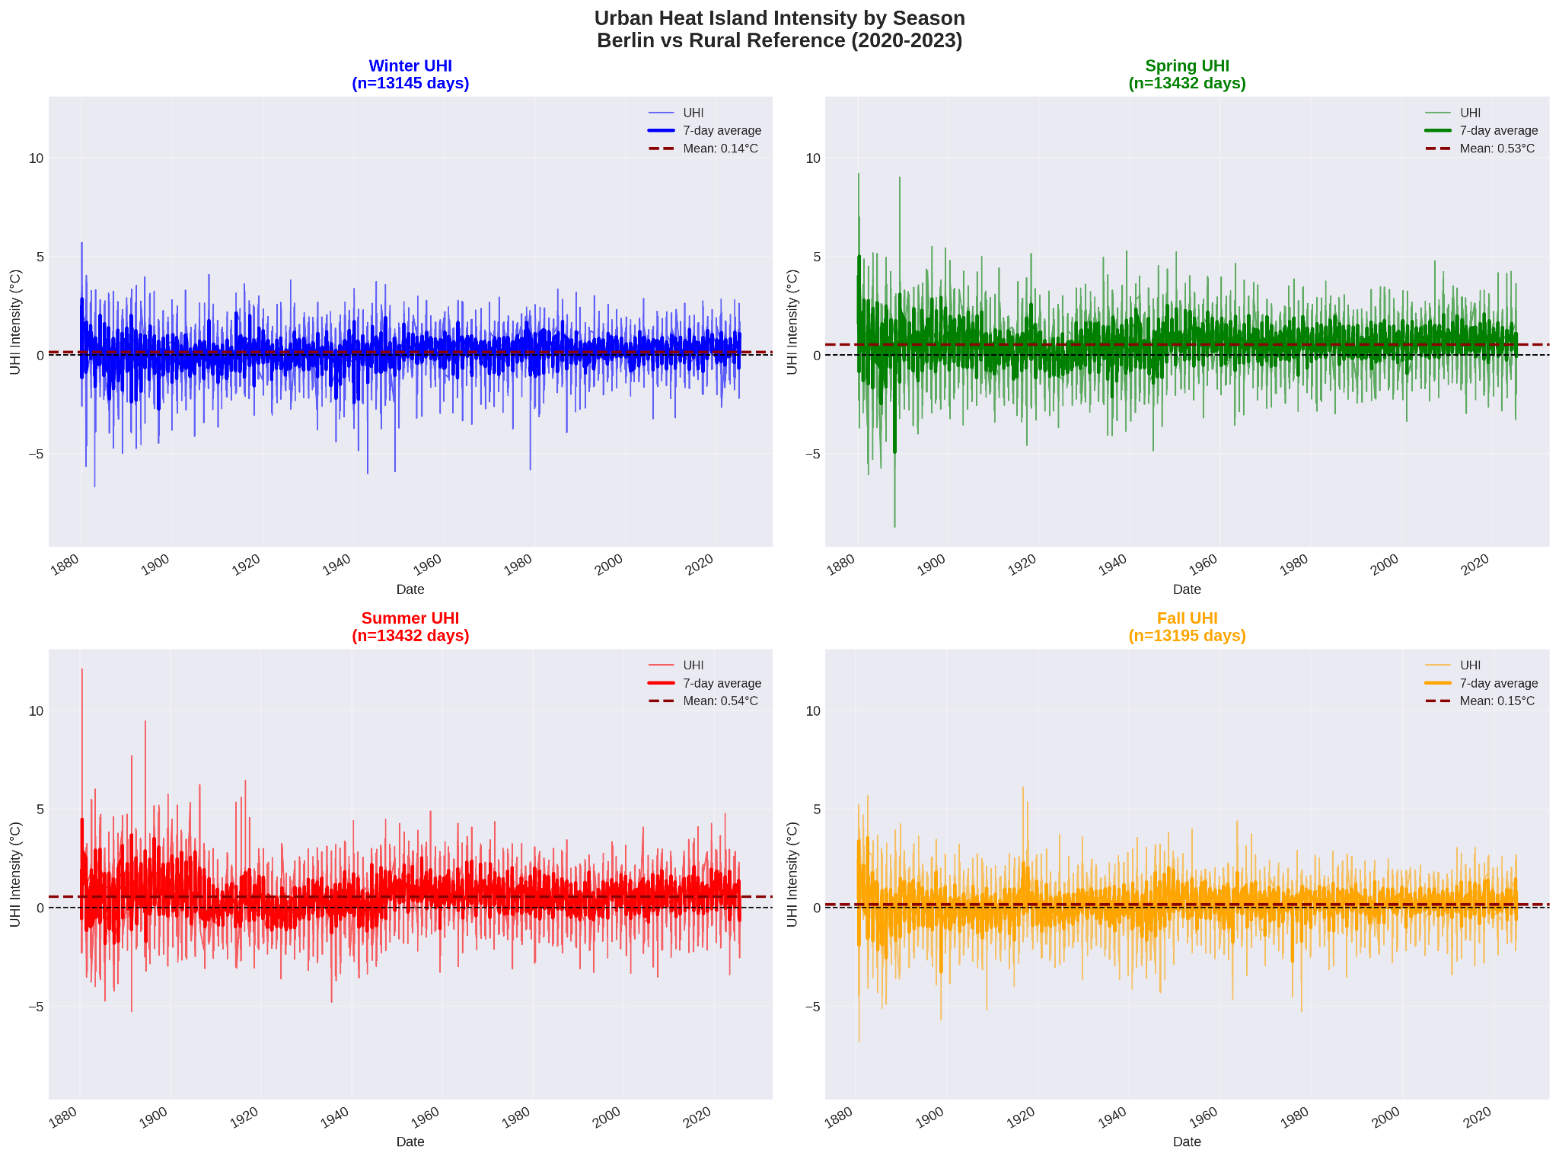
Quantitative Evidence:
Mean UHI Intensity: +0.34°C
Berlin consistently warmer than surrounding countryside
Peak intensity: +12.10°C (extreme summer event)
Key Insight: UHI 4x stronger in summer when heat matters most
Seasonal Variation:
Summer: +0.54°C ⬆️
Winter: +0.14°C ⬇️
Spring: +0.53°C,
Fall: +0.15°C

Slide 5



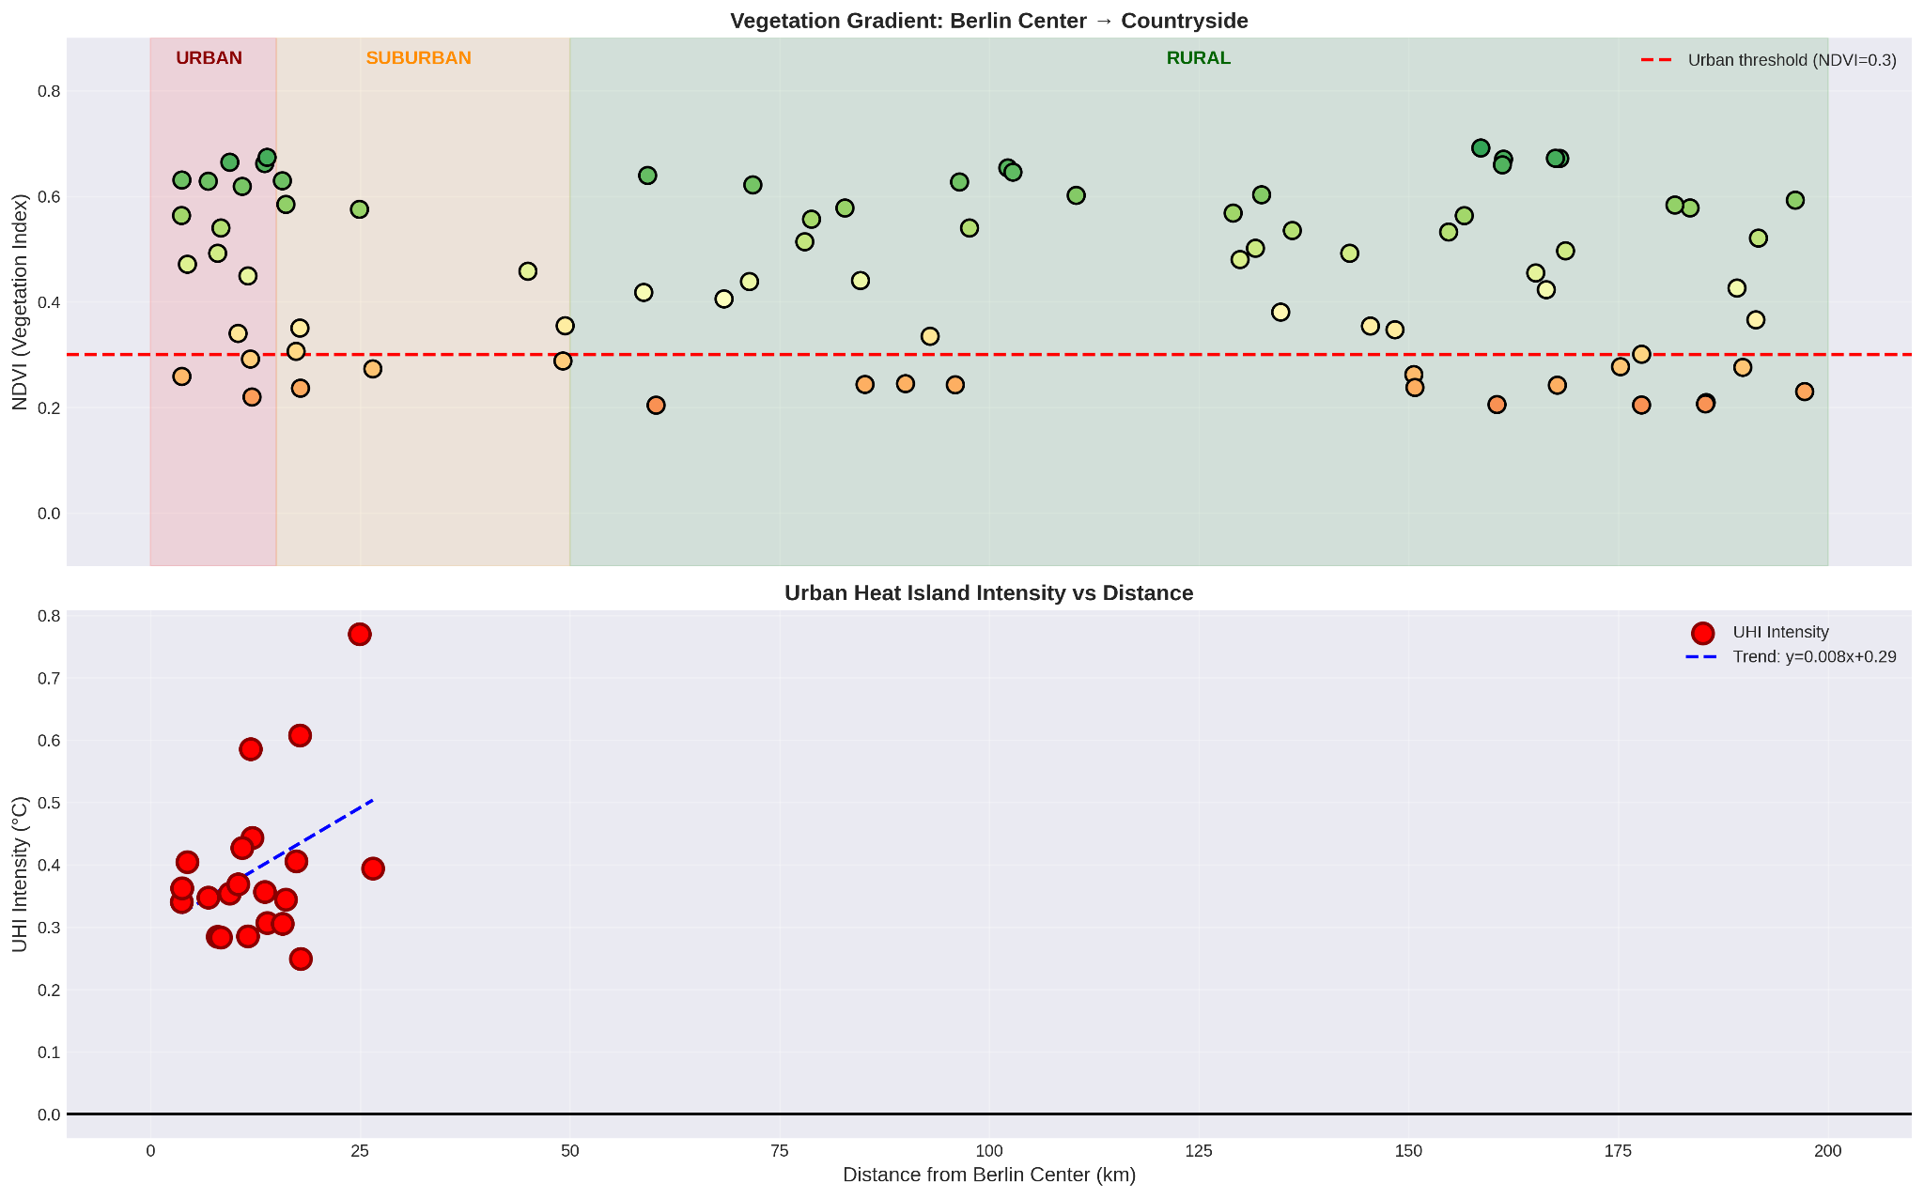
Clear Urban-Rural Gradient:
Temperature Decreases with Distance:
Strongest effects within 15km of city center
Smooth transition from urban to rural climate
Entire urban area affected, not just city core
Multi-Scale Evidence:
Regional scale shows Berlin as "heat island"
City scale reveals internal variations
Station network captures local patterns

Slide 6
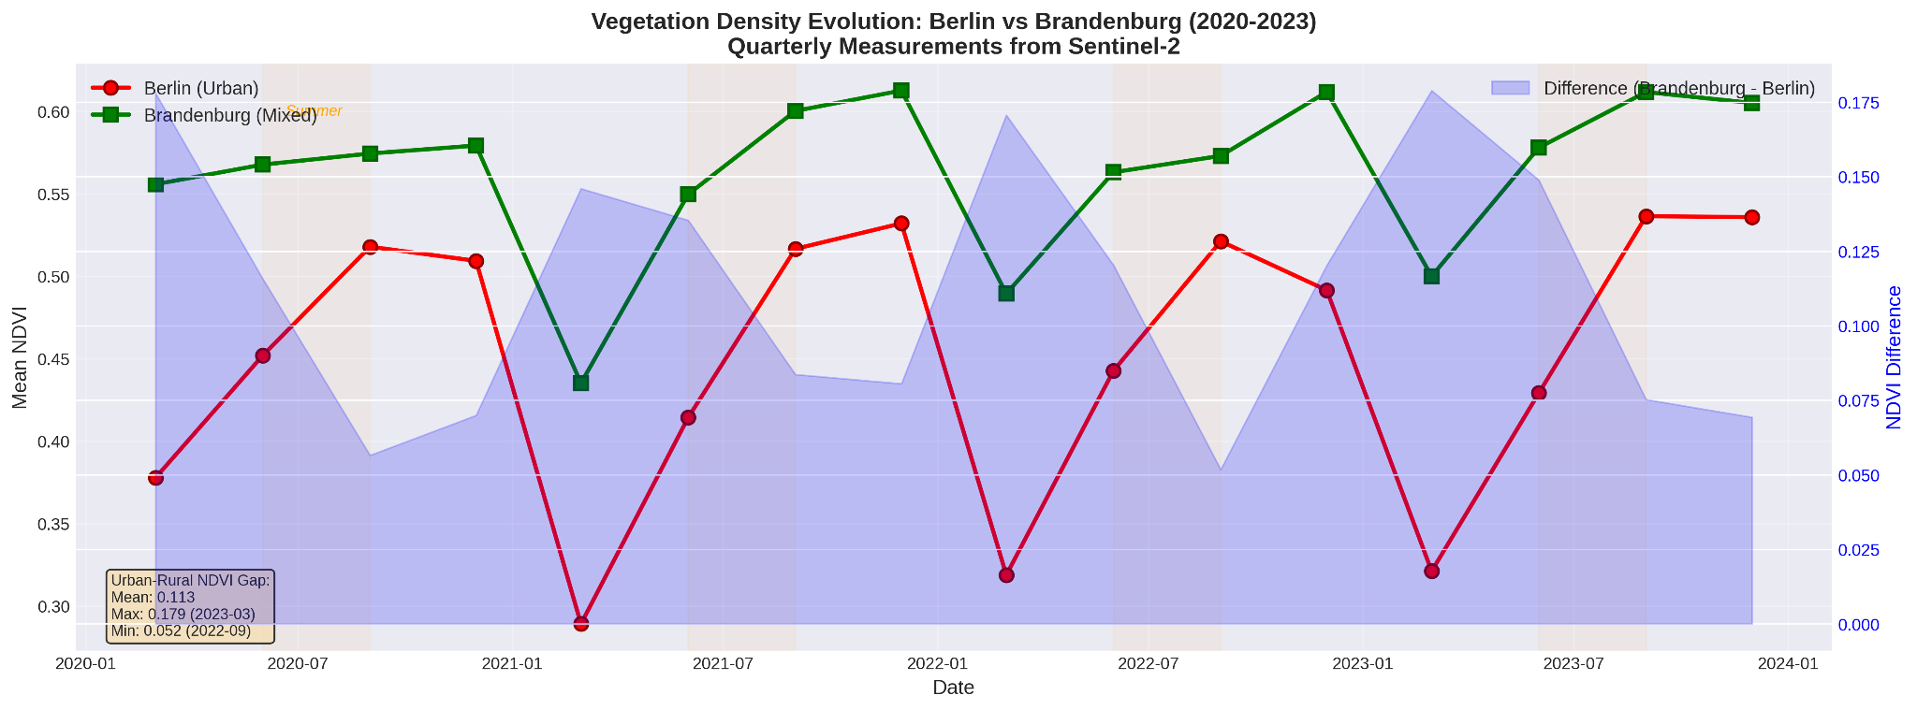
Quantifying the Green Deficit:
NDVI Analysis:
0.450
0.563
0.113
Berlin
Brandenburg
Urban-Rural Gap
(mixed urban-suburban)
(rural-vegetated)
Interpretation:
Berlin has 20% less vegetation than surroundings
Clear seasonal cycle in both regions
Persistent vegetation gap year-round

Slide 7
ERA5 Model Performance: Systematic Assessment
Overall Performance:
Correlation: 0.993 ✅
Bias: -0.97°C ❄️ (cold bias)
RMSE: 1.50°C ✅
By Zone Type:
Zone
Bias
RMSE
Correlation
Urban
-0.98°C
1.41°C
0.994
Suburban
-1.03°C
1.49°C
0.992
Rural
-0.95°C
1.51°C
0.993

Slide 8
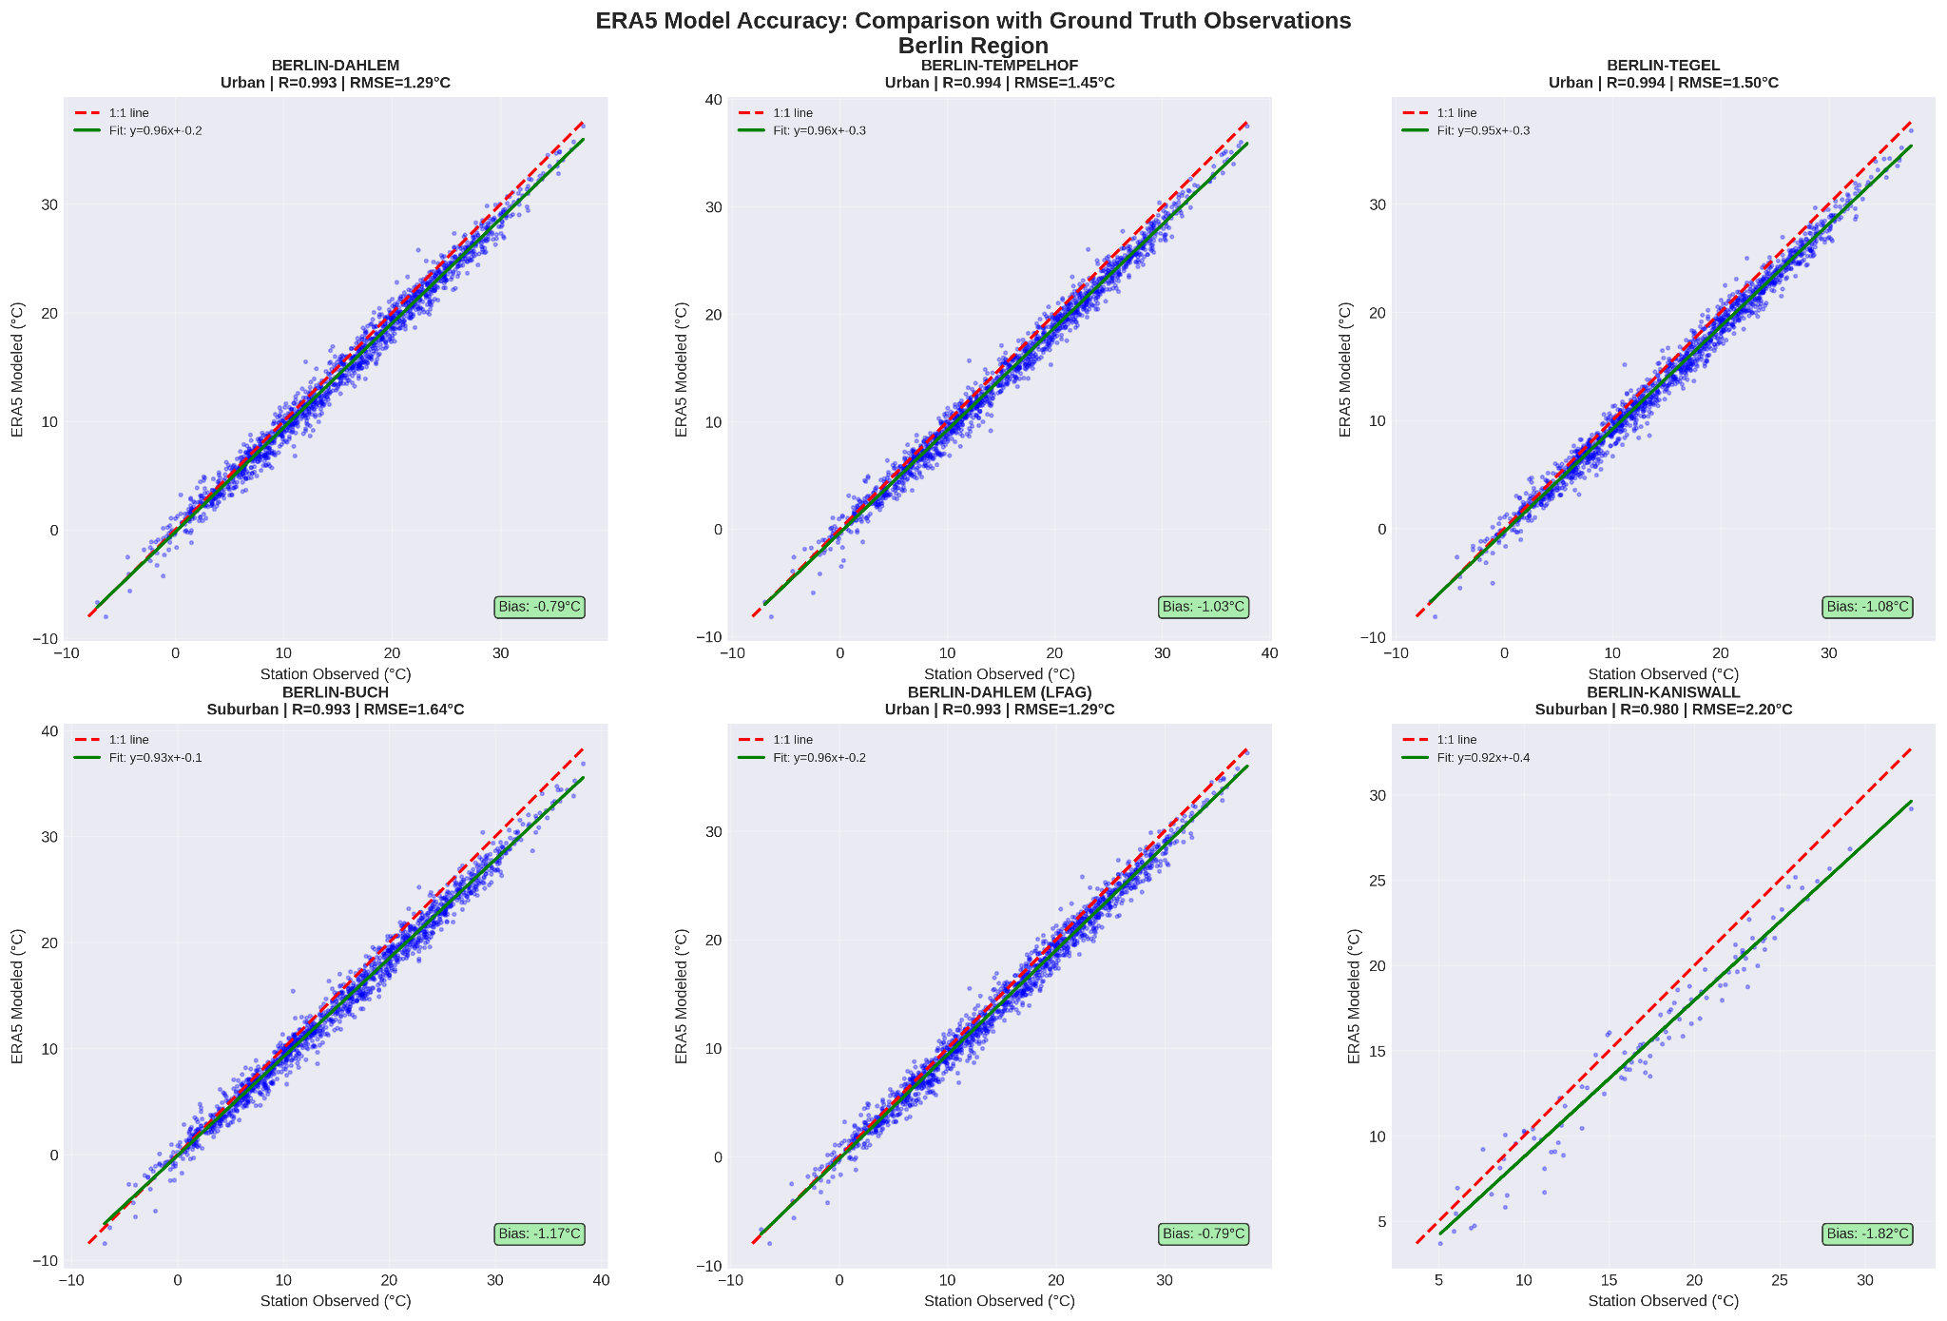
ERA5 Model Performance: Systematic Assessment

Slide 9
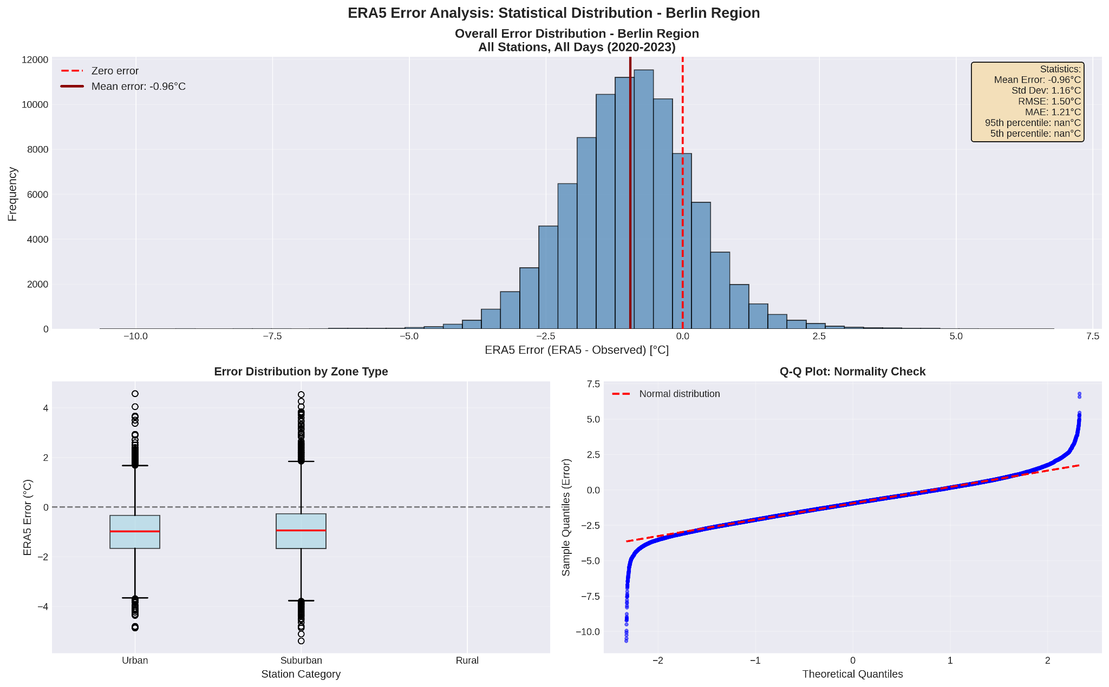
ERA5 Model Performance: Error analysis
Normally distributed errors around negative mean
Systematic Cold Bias
Good Precision, Poor Accuracy
Manageable Error Magnitude: The typical error is around 1.2°C (MAE), The RMSE of 1.5°C suggests that while most errors are small, there is a tail of larger errors that should be investigated.
-> OUTLIERS

Slide 10
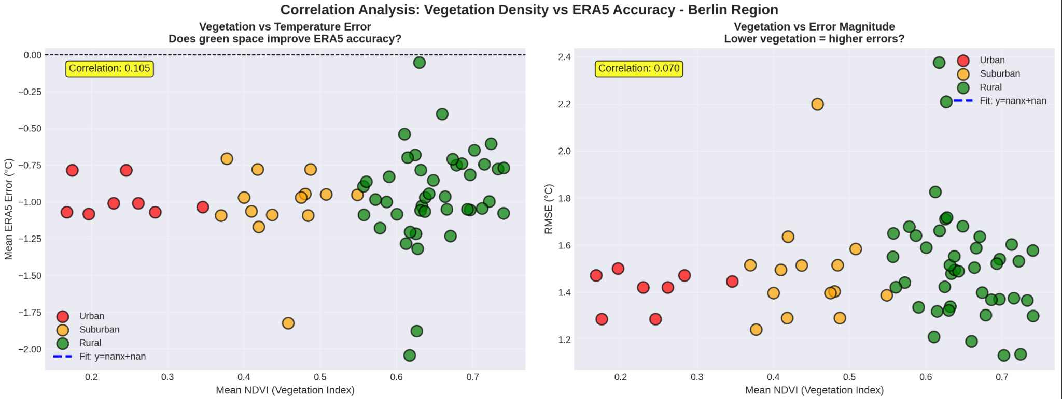
ERA5 Model Performance: Correlation NDVI - Error
No strong correlation between NDVI and ERA5 bias

Slide 11
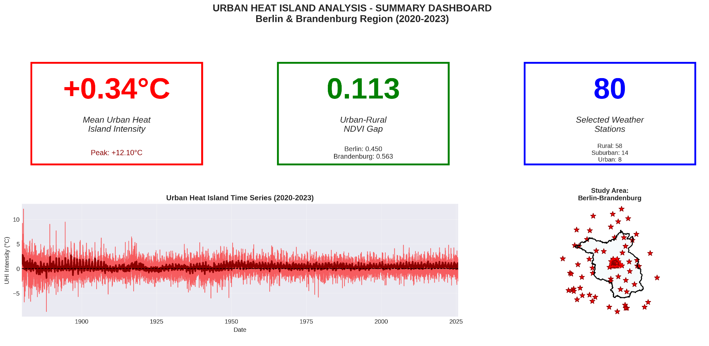
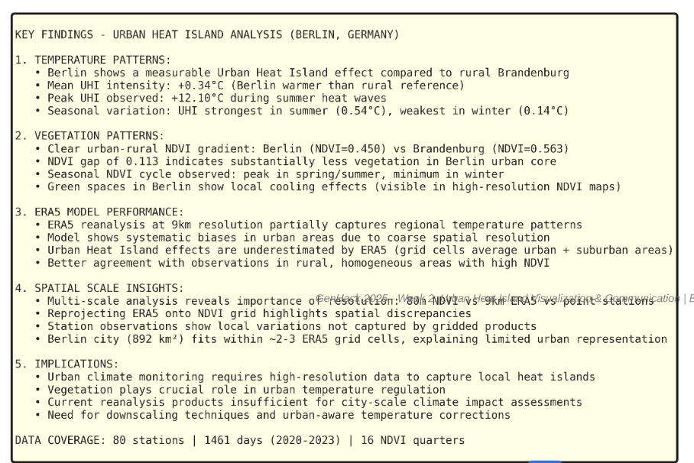
Three Main Conclusions:

